Slide 1
Applied Data Science Clustering
Dr. Omri Allouche
2017

Slide 2
K-Means
Assumes that a class has a “centroid”
Will find clusters even if none exist!
How is distance computed?
What if features are scaled?
When to stop iterating?

Slide 3
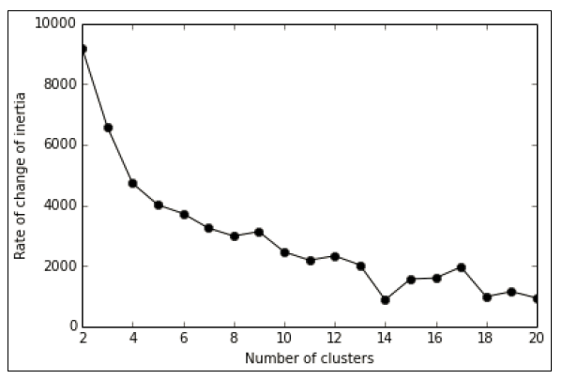
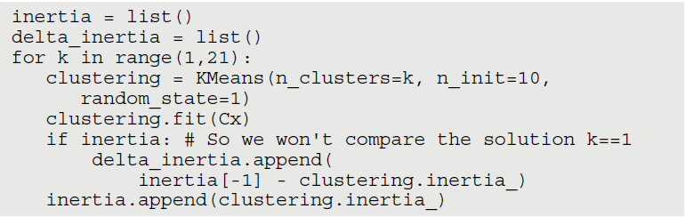
Inertia
Inertia is the sum of all the differences between every cluster member and its centroid. If the examples
in the group are similar to the centroid, the difference is small and so is the inertia.
Inertia is useful when compared to other inertia

Slide 4
Centroid-based Algorithms
1. Guess a K number of clusters.
2. Form the initial clusters.
3. Reiterate the clusters until you notice that your solution doesn’t change
anymore.

Slide 5
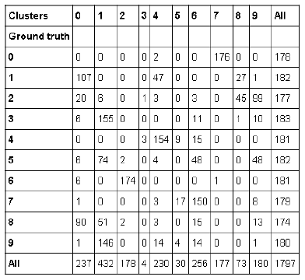
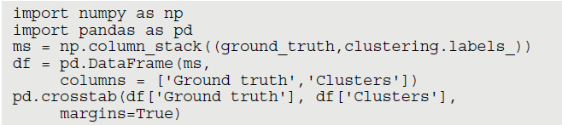

Slide 6
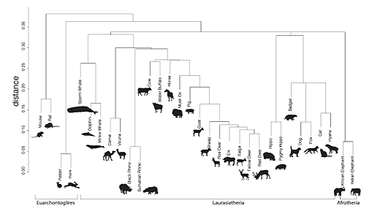
Hierarchical Clustering
Notes:
https://www.york.ac.uk/archaeology/research/featured-research/zooms-1/

Slide 7
Don’t scale well
Hierarchy + ability to cut at any point

Slide 8
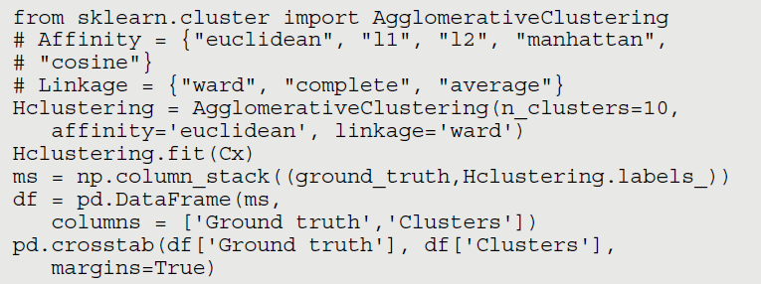

Slide 9
Combining K-means and Hierarchical Clustering
from sklearn.cluster import KMeans
clustering = KMeans(n_clusters=100, n_init=10, random_state=1)
clustering.fit(Cx)
Kx = clustering.cluster_centers_
Kx_mapping = {case:cluster for case,
cluster in enumerate(clustering.labels_)}
from sklearn.cluster import AgglomerativeClustering
Hclustering = AgglomerativeClustering(n_clusters=10, affinity='cosine', linkage='complete')
Hclustering.fit(Kx)
H_mapping = {case:cluster for case, cluster in enumerate(Hclustering.labels_)}
final_mapping = {case:H_mapping[Kx_mapping[case]] for case in Kx_mapping}

Slide 10
Distance Metrics
Euclidean (euclidean or l2): As seen in K‐means
✓✓Manhattan (manhattan or l1): Similar to Euclidean, but the distance
is calculated by summing the absolute value of the difference between
the dimensions. In a map, if the Euclidean distance is the shortest route
between two points, the Manhattan distance implies moving straight,
first along one axis and then along the other — as a car in the city
would, reaching a destination by driving along city blocks (the distance
is also known as city block distance).
Cosine (cosine): A good choice when there are too many variables and
you worry that some variable may not be significant (just noise). Cosine
distance reduces noise by taking the shape of the variables, more than
their values, into account. It tends to associate observations that have the
same maximum and minimum variables, regardless of their effective value.

Slide 11
Linkage Methods
✓✓Ward: Tends to look for spherical clusters, very cohesive inside and
extremely differentiated from other groups. Another nice characteristic
is that the method tends to find clusters of similar size. It works only
with the Euclidean distance.
✓✓Complete: Links clusters using their furthest observations, that is, their
most dissimilar data points. Consequently, clusters created using this
method tend to be comprised of highly similar observations, making the
resulting groups quite compact.
✓✓Average: Links clusters using their centroids and ignoring their boundaries.
The method creates larger groups than the complete method. In
addition, the clusters can be different sizes and shapes, contrary to the
Ward’s solutions. Consequently, this average, multipurpose, approach
sees successful use in the field of biological sciences.

Slide 12
Density Based: DB-Scan
Slower than K-Means, faster than hierarchical clustering
Finds the number of clusters itself
Requires setting 2 parameters:
✓eps: The maximum distance between two observations that allows them
to be part of the same neighborhood.
✓min_sample: The minimum number of observations in a neighborhood
that transform them into a core point.
from sklearn.cluster import DBSCAN
DB = DBSCAN(eps=4.35, min_samples=25, random_state=1)
DB.fit(Cx)

Slide 13
